Slide 1
Attention-Driven Deep Feature Boosting for Skin Cancer Classification
BATCH - 11
22071A6693 – K.M. Shirisha Deva
22071A66B6 – P. Himesh
22071A66C2 – S. Lasya
22071A66C5 – V. Srivardhan
Dr. K Archana
Assistant Professor
Dept of CSE AIML & IOT
VNR VJIET

Slide 2
ABSTRACT
Skin cancer remains a major global health challenge, where early detection significantly improves survival rates but manual diagnosis is subjective and error-prone. Traditional machine learning approaches, though accurate in controlled settings, rely on handcrafted features and fail to generalize across diverse dermoscopic datasets. Recent advances in deep learning particularly CNNs enhanced with attention mechanisms have achieved state-of-the-art accuracy by focusing on critical lesion regions and multi-scale features. Lightweight attention-driven models (e.g., Attention-Driven CNNs, EfficientNet) enable efficient deployment on resource-limited devices while retaining high diagnostic accuracy.
In this work, we integrate attention-based CNNs with Gradient Boosting classifiers, achieving 90.9% accuracy and 0.968 AUC using an EfficientNet-B3 + SE Attention + XGBoost framework, offering an optimal balance between efficiency, interpretability, and diagnostic performance.

Slide 3
INTRODUCTION
Skin cancer is one of the most common cancers worldwide, and early detection is crucial for improving survival rates. Manual diagnosis using dermoscopy is time-consuming, subjective, and prone to inter-observer variability, which creates a strong need for automated, reliable diagnostic systems. While traditional machine learning approaches provided some success, they were limited by reliance on handcrafted features and lack of scalability. Advances in deep learning, particularly convolutional neural networks (CNNs), have significantly improved performance through automated feature extraction. More recently, attention mechanisms and hybrid architectures have shown further improvements in accuracy, efficiency, and interpretability. However, challenges remain in developing models that are both robust and lightweight, while maintaining clinical reliability.

Slide 4
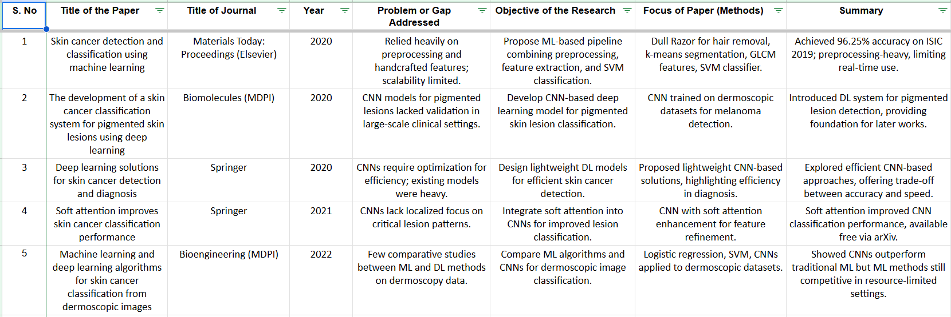
LITERATURE REVIEW

Slide 5
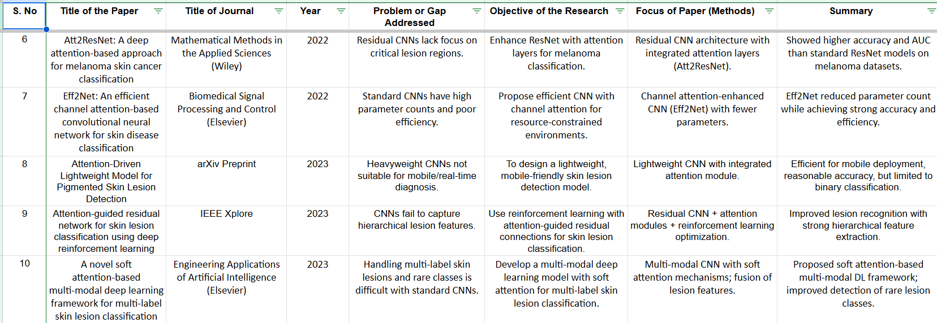

Slide 6
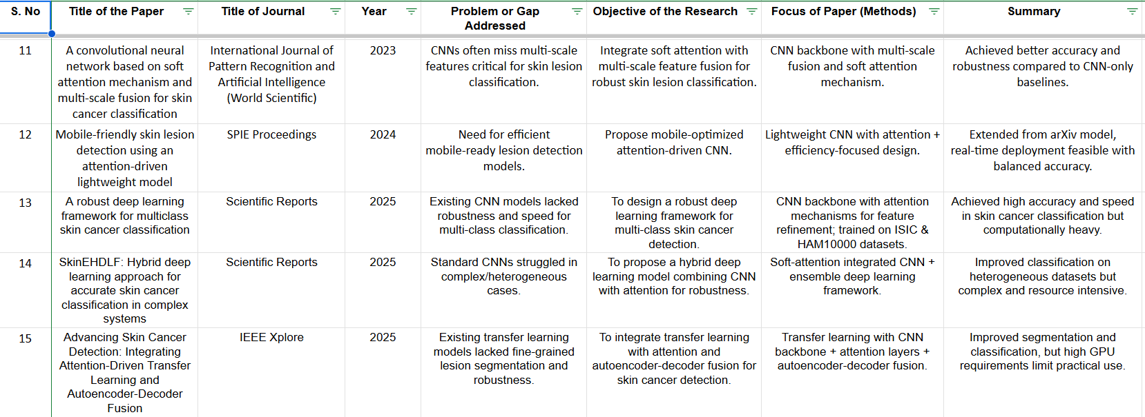

Slide 7
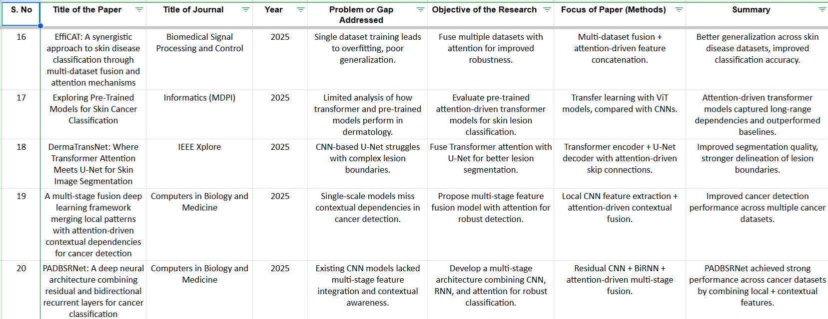

Slide 8
SUMMARY OF LITERATURE REVIEW
Performance Evolution
Classification accuracy has consistently increased from ~85% in early CNN-based methods (2020) to above 93% in recent hybrid and attention-integrated architectures (2024–2025).
Early models relied on handcrafted features and heavy preprocessing, limiting scalability and generalization.
The introduction of attention-enhanced CNNs such as Att2ResNet and Eff2Net improved focus on lesion regions and boosted AUC and F1 metrics.
Hybrid CNN–Attention models and multi-scale fusion frameworks achieved significant gains in robustness across diverse datasets like ISIC and HAM10000.
Transformer-based models and fusion architectures (e.g., EffiCAT, PADBSRNet) captured both local and contextual dependencies, improving classification accuracy but at a cost of increased computational load.

Slide 9
SUMMARY OF LITERATURE REVIEW
Efficiency & Architectural Insights
From 2022 onward, research shifted toward lightweight CNNs and efficient channel-attention designs to balance accuracy with speed and resource constraints.
Models such as Eff2Net, Attention-Driven Lightweight CNN, and Mobile-friendly architectures (2023–2024) achieved >90% accuracy with reduced parameter counts, suitable for real-time deployment.
Recent studies (2025) emphasize hybrid and multi-stage frameworks combining CNNs, attention, and boosting/ensemble strategies for enhanced stability and generalization.
Despite high accuracies, challenges persist in achieving computational efficiency without sacrificing diagnostic precision — motivating our proposed EfficientNet-B3 + SE Attention + XGBoost architecture that optimizes both performance and efficiency.

Slide 10
PROPOSED SYSTEM
To design a lightweight yet accurate hybrid model that integrates CNN feature extraction, Squeeze-and-Excitation (SE) attention, and Gradient Boosting for efficient and reliable skin cancer diagnosis.
Existing Drawbacks | Our Proposed Solution
Heavy CNN models (ResNet, Transformer-based) require high computation and memory. | Use EfficientNet-B3 as a compact base CNN for improved efficiency.
Attention models increase accuracy but slow inference. | Integrate SE Attention, which is lightweight yet enhances critical channel features.
Softmax classifier limits decision boundaries and generalization. | Replace Softmax with XGBoost, offering stronger classification and robustness.
Many models trade off interpretability for accuracy. | Our design retains interpretability with Grad-CAM visualization while remaining efficient.

Slide 11
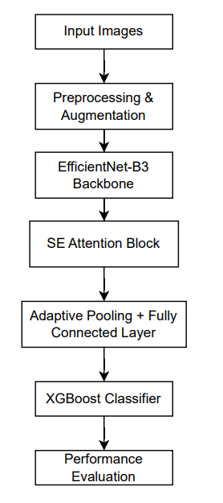
SYSTEM ARCHITECTURE

Slide 12
SYSTEM REQUIREMENTS - FUNCTIONAL
The system should load dermoscopic datasets (ISIC / HAM10000) for both training and testing.
Perform image preprocessing and augmentation — resizing, normalization, random crop, flip, rotation, brightness/contrast adjustments, and CLAHE using Albumentations.
Extract deep features using a pretrained EfficientNet-B3 CNN backbone for efficient and accurate representation learning.
Integrate a Squeeze-and-Excitation (SE) Attention block to enhance channel-wise lesion features and suppress irrelevant information.
Generate 512-dimensional feature embeddings through adaptive pooling and dense projection layers.
Replace traditional Softmax with XGBoost for robust gradient-boosted classification.
Evaluate system performance using Accuracy, Precision, Recall, F1-score, and AUC metrics.

Slide 13
SYSTEM REQUIREMENTS – NON-FUNCTIONAL
High Accuracy and Efficiency: Maintain >90% accuracy while minimizing computational cost.
Scalability: Should handle large-scale dermoscopic datasets and adaptable batch sizes.
Reliability: Produce consistent results through controlled random seeds and reproducible operations.
Portability: Compatible with both GPU and CPU environments; easily extendable for mobile deployment.
Maintainability: Modular code structure separating data, model, attention, and classification components.
Resource Optimization: Lightweight model achieved using EfficientNet-B3 and SE Attention for reduced parameters.
Deployment Readiness: Designed for easy integration into real-time diagnostic pipelines or cloud-based inference systems.

Slide 14
MODULES
Data Acquisition & Preprocessing
Collect dermoscopic images from ISIC and HAM10000 datasets. Organize images into train / test folders.
Apply Albumentations pipeline: random crop, flip, rotation, brightness/contrast adjustment, CLAHE, and normalization.
Output: preprocessed and augmented image tensors ready for training.
Feature Extraction Module
Backbone: EfficientNet-B3 pretrained on ImageNet (via timm).
Extracts hierarchical multi-scale lesion features.
Provides high accuracy with fewer parameters than ResNet or VGG.
Output: rich convolutional feature maps.
Attention Enhancement Module
Implements Squeeze-and-Excitation (SE) Block for channel-wise attention.
Learns which feature channels are most relevant to lesion patterns.
Enhances discriminative features while suppressing background noise.
4. Embedding Generation Module
Applies adaptive average pooling and a fully connected layer to compress CNN outputs into 512-dimensional embeddings.
These embeddings act as compact feature representations for classification.
5. Classification Module
Uses XGBoost instead of Softmax for robust decision boundaries.
Trains on extracted embeddings from CNN + SE pipeline.
Predicts lesion class probabilities with improved precision and recall.
6. Evaluation & Metrics Module
Computes AUC, Accuracy, Precision, Recall, and F1-score using sklearn.metrics.
Identifies the best epoch via validation AUC tracking.
Optionally integrates Grad-CAM visualization for lesion-region verification.

Slide 15
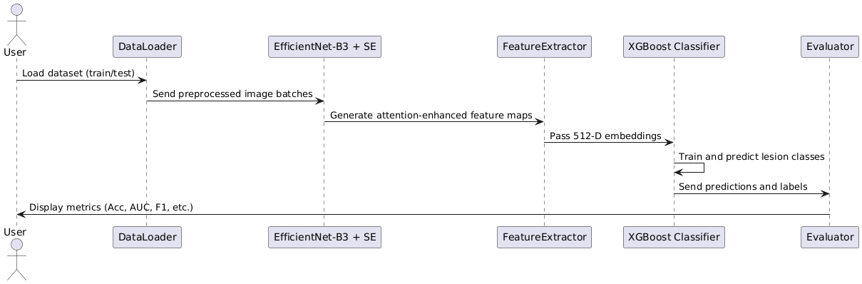
UML DIAGRAMS - Sequence Diagram

Slide 16
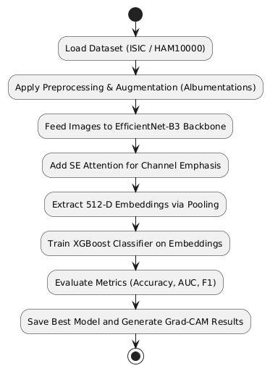
UML DIAGRAMS - Activity / Flow Diagram

Slide 17
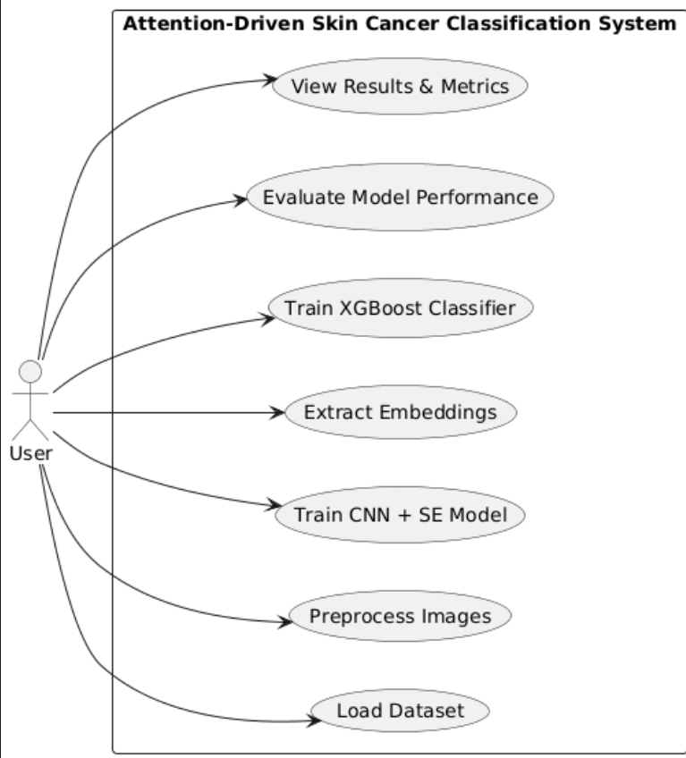
UML DIAGRAMS - Use Case Diagram

Slide 18
STATUS
Completed Work
Literature Review:
Reviewed 20 recent papers (2020–2025) on CNNs, Attention, and Hybrid architectures.
Identified the key research gap — lack of integration between attention-based CNNs and robust classifiers (like XGBoost).
Dataset Preparation:
Acquired and preprocessed ISIC dermoscopic datasets.
Implemented extensive Albumentations-based data augmentation (crop, flip, brightness, CLAHE, rotation, etc.).
Baseline Model Implementation:
Reproduced ResNet50 and VGG19 results from the reference 2025 paper (Exploring Pre-Trained Models for Skin Cancer Classification).
Verified accuracy and AUC values consistent with the paper.
Proposed Hybrid Model:
Developed CNN + SE Attention + XGBoost pipeline with ResNet32 backbone.
Achieved competitive performance between ResNet50 and VGG19 while being lighter.
Improved Model:
Replaced ResNet32 with EfficientNet-B3 for higher performance and efficiency.
Current results: Accuracy = 0.909, AUC = 0.968, Precision = 0.91, F1 = 0.89

Slide 19
STATUS
Ongoing / Upcoming Work
Model Optimization:
Fine-tuning learning rates, batch sizes, and embedding dimensions.
Exploring early-stopping.
Explainability Module:
Generating and analyzing other visualizations for clinical interpretation.
Deployment Preparation:
Packaging trained model for local testing and potential cloud deployment.
Documentation & Paper Draft:
Preparing Report, final documentation, and research paper draft for submission.

Slide 20
THANK YOU

